Slide 1
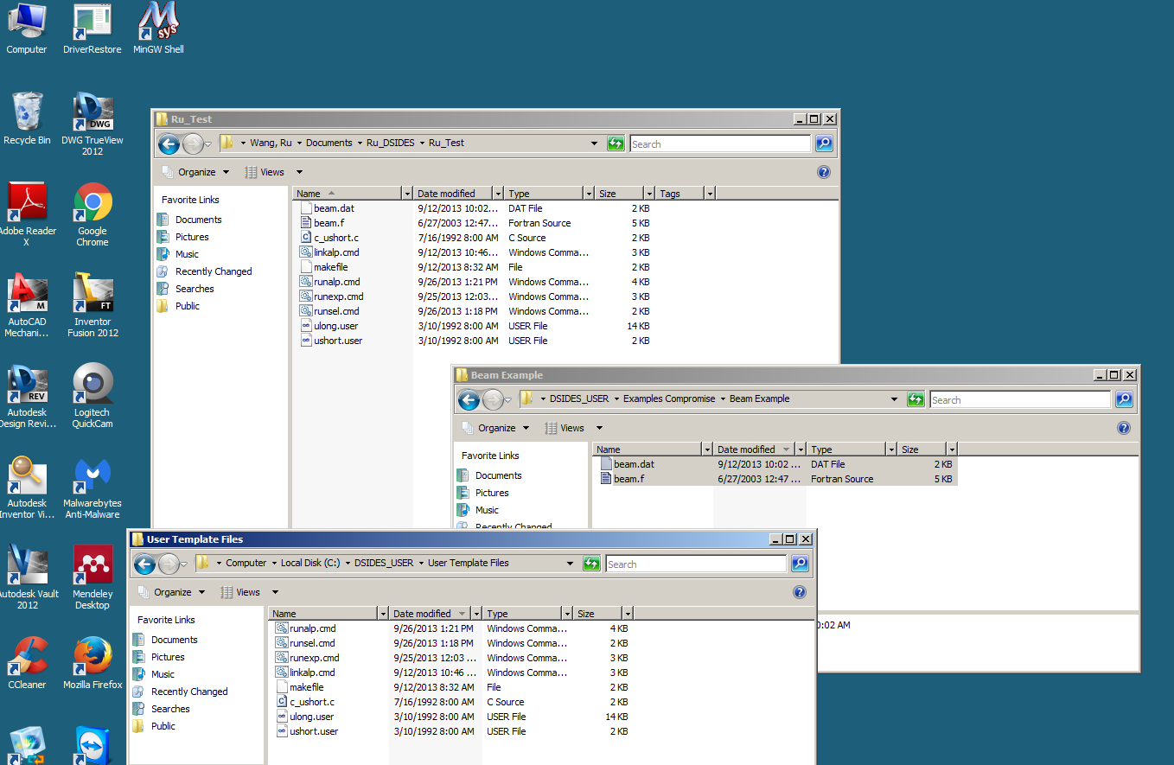

Slide 2
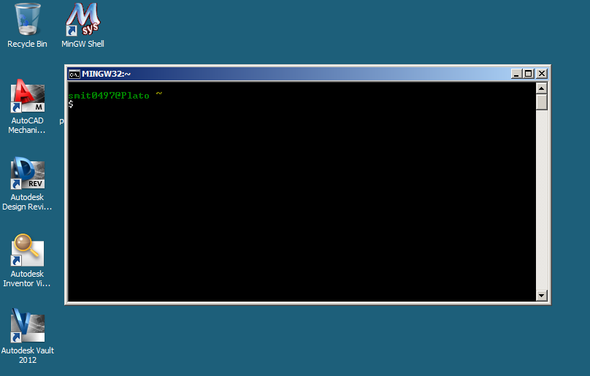
Execute shortcut on desktop
Launches MinGW window – screen above appears

Slide 3
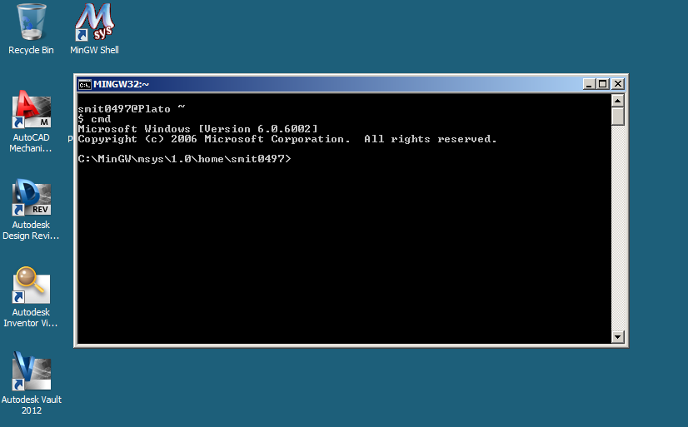
Enter “cmd” to go to command window in MinGW environment
Default directory will not be your standard user area

Slide 4
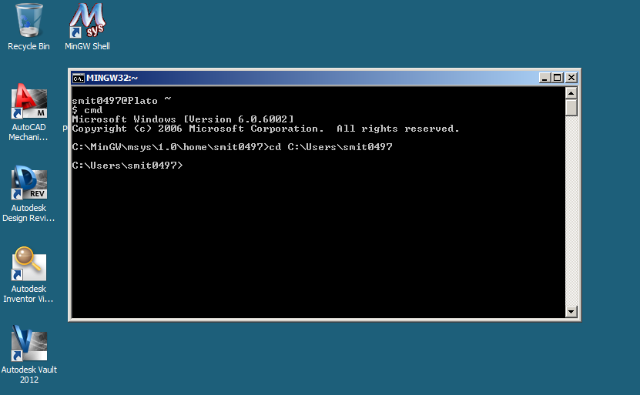
Change directory to navigate to correct directory
Eg. cd C:\Users\smit0497
Legal commands in shell can be found at
An A-Z Index of the Windows CMD command line
http://ss64.com/nt/

Slide 5
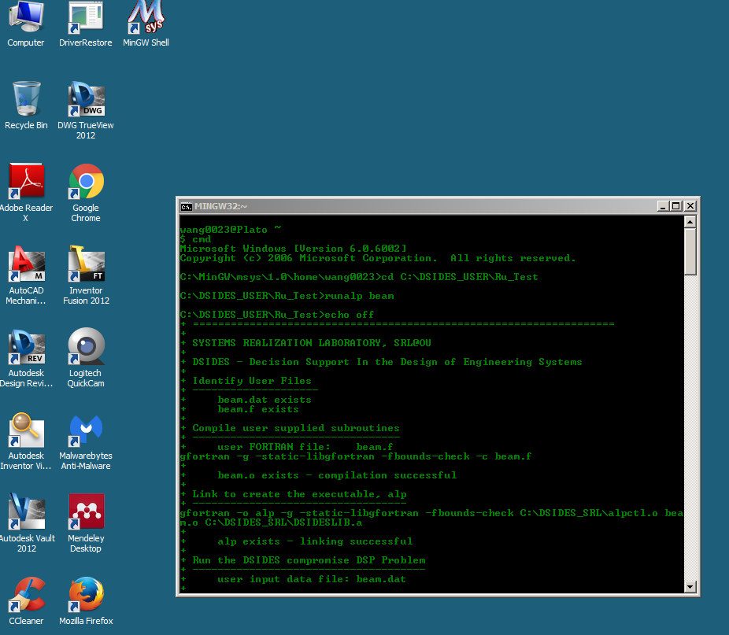
Run Command: runalp mycomp(.f file name)

